Slide 1
Database system
Saba Ghani
FAST-NU
Chiniot Faisalabad Campus

Slide 2
Aliasing Table Names
A table alias is created by directly placing an alias after the table name in the FROM clause.
For example, in the following example we will refer to departments table as d or dept.
SELECT d.dname
FROM departments d
WHERE d.dno = 1;
SELECT dept.dname
FROM departments dept
WHERE dept.dno = 1;

Slide 3
Join
SQL Join is used to fetch data from two or more tables, which is joined to appear as single set of data.
Using values common to both tables
To perform join, include more than one table in FROM clause.
Use comma as separator and typically include WHERE clause to specify join column(s).
Also possible to use an alias for a table named in FROM clause.
Alias is separated from table name with a space.
Alias can be used to qualify column names when there is ambiguity

Slide 4
Join
Example “List all orders, showing the order number and amount, and the name and credit limit of the customer who placed it.”
The four specific data items requested are clearly stored in two different tables
The ORDERS table contains the order number and amount of each order but doesn’t have customer names or credit limits.
The CUSTOMERS table contains the customer names and balances, but it lacks any information about orders.

Slide 5
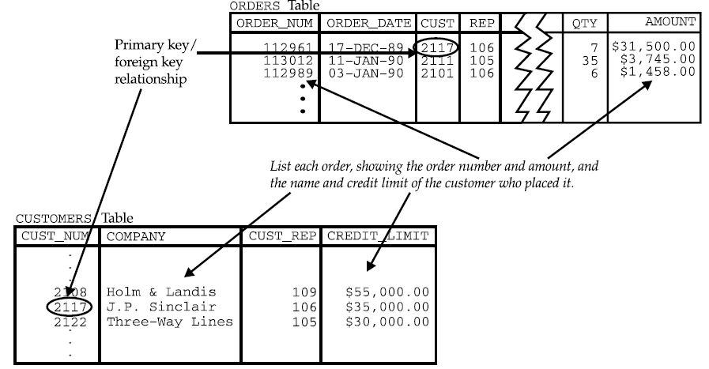
Join

Slide 6
Types of Join
Cross/cartesian join
Inner or equi join
Self join
outer joins
Left Outer Join
Right Outer Join
Full Outer Join

Slide 7
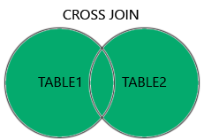
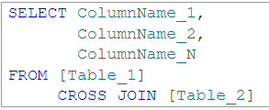

Cartesian/cross join
The CROSS JOIN returns all records from both tables (table1 and table2).
This join is formed when:
A join condition is omitted
All rows in the first table are joined to all rows in the second table
Syntax

Slide 8
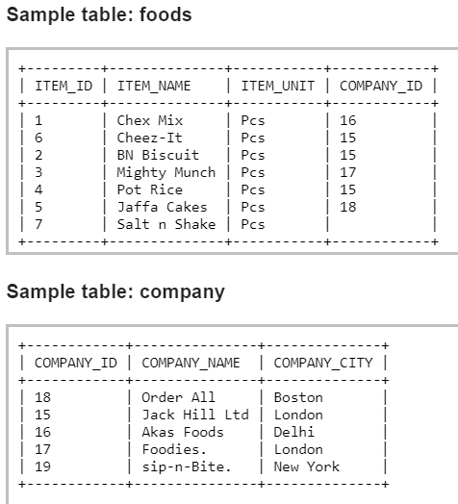
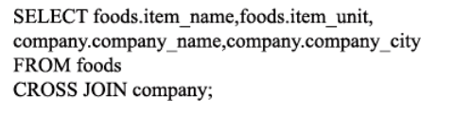
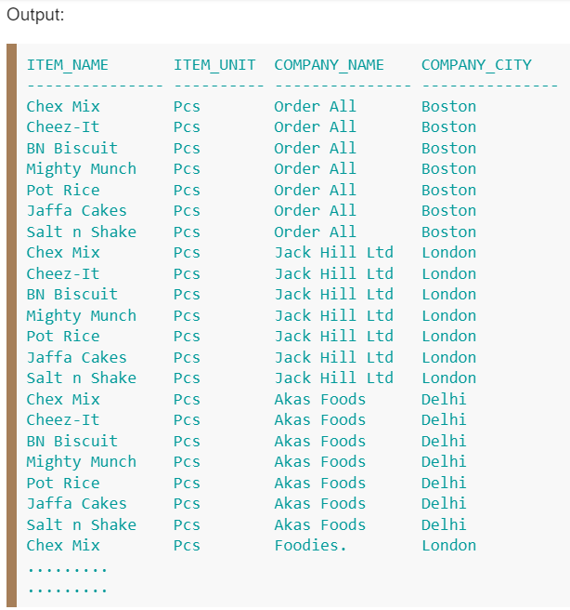
Cartesian/cross join Example

Slide 9
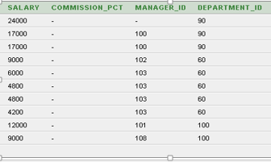
INNER OR EQUI JOIN
This is a simple JOIN in which the result is based on matched data as per the equality condition specified in the query.
A join based on an exact match between two columns is more precisely called an equi-join
Example
Select * From employees ,departments
Where employees.department_id=departments.department_id;

Slide 10
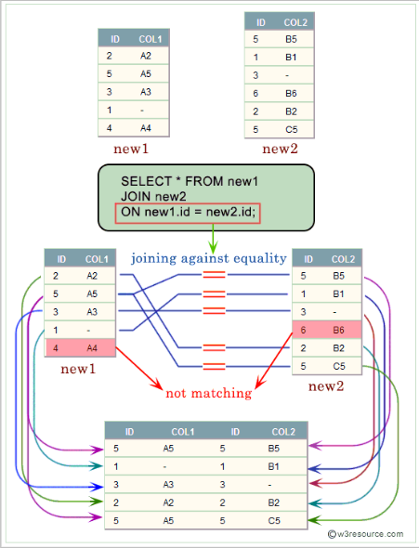
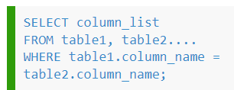
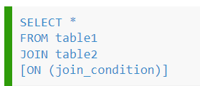

INNER OR EQUI JOIN

Slide 11
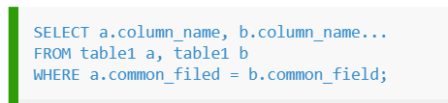
Self Join
Some multi table queries involve a relationship that a table has with itself
A self join is a join in which a table is joined with itself (which is also called Unary relationships)
The self join can be viewed as a join of two copies of the same table.
To distinguish the column names from one another, aliases for the actual table name are used, since both the tables have the same name.
Syntax

Slide 12
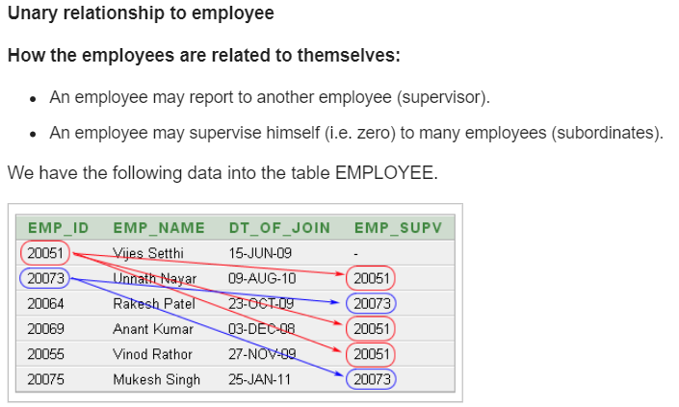
Self join example

Slide 13
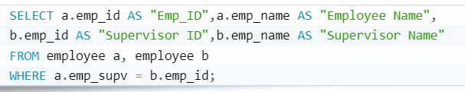
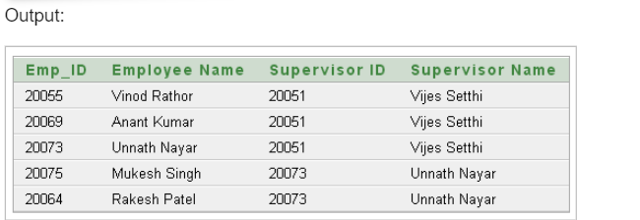
Self join example
If we want a list of employees and the names of their supervisors, we’ll have to JOIN the EMPLOYEE table to itself to get this list.

Slide 14
Outer Join
Outer Join is based on both matched and unmatched data.
With an inner join, if one row of a table is unmatched, row is omitted from result table.
The outer join operations retain rows that do not satisfy the join condition.
The SQL OUTER JOIN operator (+) is used only on one side of the join condition only.
There are three types of OUTER JOIN
Left Outer Join
Right Outer Join
Full Outer Join

Slide 15
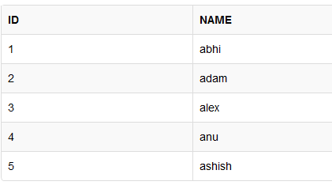
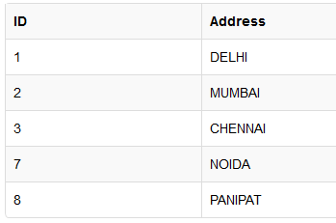
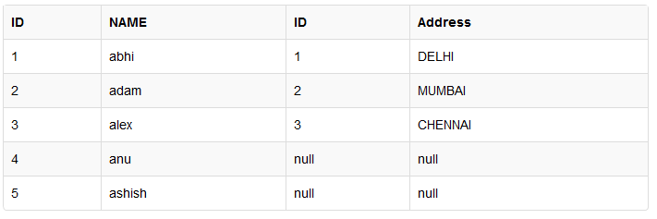
Left outer join
Return only matched value
Remaining row of left table and NULL value to the right table.
Select * from class left outer join class_info ON(class.ID=class_info.ID);
class
Class_info

Slide 16
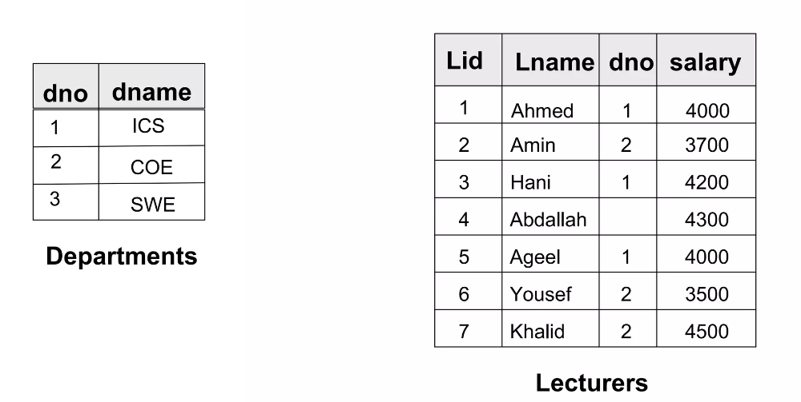
Example tables

Slide 17
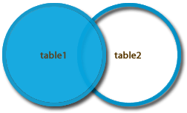
Left Outer Join
SELECT a.*, b.*
FROM lecturers a,
Departments b
WHERE a.dno = b.dno(+)
Lid
Lname
dno
salary
dno
dname
1
Ahmed
1
4000
1
SE
2
Amin
2
3700
2
SWE
3
Hani
1
4200
1
ICS
5
Ageel
1
4000
1
SWE
6
Yousef
2
3500
2
COE
7
Khalid
2
4500
2
COE
4
Addella
4300

Slide 18
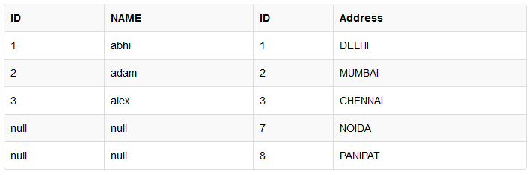
Right outer Join
The right outer join returns a result table with the matched data of two tables
remaining rows of the right table and null for the left table's columns.
Select * from class right outer join class_info ON(class.ID=class_info.ID)

Slide 19
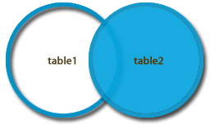
Right outer Join
If We want to Include in the output table the departments with no lecturers we rewrite our previous query as follows
Lid
Lname
dno
salary
dno
dname
1
Ahmed
4
4000
4
SE
2
Amin
3
3700
3
SWE
3
Hani
1
4200
1
ICS
5
Ageel
3
4000
3
SWE
6
Yousef
2
3500
2
COE
7
Khalid
2
4500
2
COE
SELECT a.*, b.*
FROM lecturers a,
Departments b
WHERE a.dno (+) = b.dno
5
NW

Slide 20
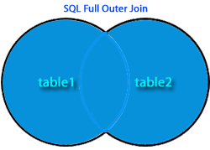
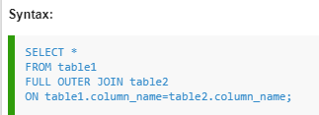
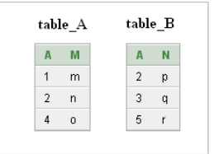
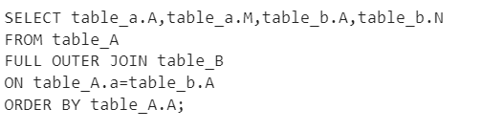
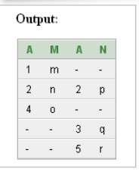
Full Outer join
Combines the results of both left and right outer joins and returns all (matched or unmatched) rows from the tables on both sides of the join clause.

Slide 21
Full Outer Join
If We want to Include in the output table the departments with no lecturers and the lecturers with unknown departments we rewrite our previous query as follows
Lid
Lname
dno
salary
dno
dname
1
Ahmed
4
4000
4
SE
2
Amin
3
3700
3
SWE
3
Hani
1
4200
1
ICS
5
Ageel
3
4000
3
SWE
6
Yousef
2
3500
2
COE
SELECT a.*, b.*
FROM lecturers a,
Departments b
WHERE a.dno (+) = b.dno
UNION
SELECT a.*, b.*
FROM lecturers a,
Departments b
WHERE a.dno= b.dno (+);
7
Khalid
2
4500
2
COE
5
NW
4
Abdella
4300

Slide 22
Characteristics of OUTER join
Left Outer Join:
Includes those rows of first (left) table unmatched with rows from second (right) table.
Columns from second table are filled with NULLs.
Right outer Join :
includes those rows of second (right) table that are unmatched with rows from first (left) table.
Columns from first table are filled with NULLs.
Full Outer Join:
Is the UNION of both left and right outer joins.

Slide 23
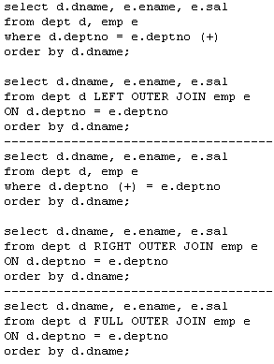

Slide 24
Union, Intersection and Difference
UNION OPERATOR
The SQL UNION operator is used to combine the result sets of 2 or more SELECT statements. It removes duplicate rows between the various SELECT statements.
Each SELECT statement within the UNION must have the same number of fields in the result sets with similar data types
UNION ALL does not remove duplicate rows.
SELECT supplier_id FROM suppliers UNION SELECT supplier_id FROM orders ORDER BY supplier_id;

Slide 25
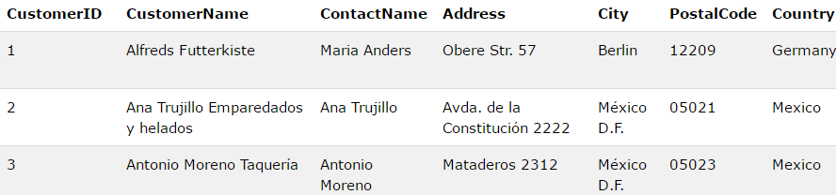
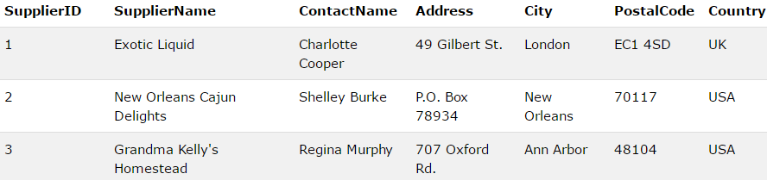
SELECT City, Country FROM Customers WHERE Country='Germany' UNION ALL SELECT City, Country FROM Suppliers WHERE Country='Germany' ORDER BY City;

Slide 26
List all the ICS and COE faculty salaries. Remove duplicates

Slide 27
List all the ICS and COE faculty salaries. Remove duplicates
SELECT salary
FROM lecturers
WHERE dno =
( SELECT dno
FROM departments
WHERE dname= ‘ICS’
)
UNION
SELECT salary
FROM lecturers
WHERE dno =
( SELECT dno
FROM departments
WHERE dname= ‘COE’
)

Slide 28
List all the ICS and COE faculty salaries. Include duplicates

Slide 29
SELECT salary
FROM lecturers
WHERE dno =
( SELECT dno
FROM departments
WHERE dname= ‘ICS’
)
UNION ALL
SELECT salary
FROM lecturers
WHERE dno =
( SELECT dno
FROM departments
WHERE dname= ‘COE’
)

Slide 30
Difference
List salaries that are taken by ICS and not COE lecturers.
SELECT salary
FROM lecturers
WHERE dno = (
SELECT dno
FROM departments
where dname= ‘ICS’
)
MINUS
SELECT salary
FROM lecturers
WHERE dno = (
SELECT dno
FROM departments
WHERE dname= ‘COE’
)

Slide 31
Intersection
List salaries that are taken by both COE and ICS lecturers.
SELECT salary
FROM lecturers
WHERE dno = (
SELECT dno
FROM departments
where dname= ‘ICS’
)
INTERSECTION
SELECT salary
FROM lecturers
WHERE dno = (
SELECT dno
FROM departments
WHERE dname= ‘COE’
)
Produces result tables from both queries and creates single result table consisting of those rows that are common to both result tables.

